Slide 1



Airport Database
ENTITY – RELATIONSHIP MODEL

Slide 2
SQL - RDWH Project - Group 1
Participants:
Amol Nikam - H22002
Anoushka Rao - H22004
Sidharth Khurana - H22016
Faculty:
Prof. Saurabh Sinha

Slide 3
Contents
Business Scope
Normalization
Key Entities
ER Diagram
Table Details - Database diagram
Database Deployment files
Use Cases
Query
Output

Slide 4



Business Scope
Designing a Database for an Airport represents a complex undertaking, covering different entities interacting with each other under the Airport umbrella
E-R model designed represents capturing and storing data for the entities in a non redundant manner, encapsulating different relationships of entities with each other
Creating the E-R Diagram
Normalizing the E-R Diagram
Designing the Database
Steps Followed -

Slide 5
Achieving Normalization
In RDBMS, nothing is considered as fully normalized. To create a normalized database, followed the below sequence
For First Normal Form – Divided the multi value attributes into atomic values
Second Normal Form – Worked on removing partial dependency on any key which is part of a composite primary key.
Third Normal Form - Worked on removing Transitive Dependencies on the primary key attribute in the tables

Slide 6
Key Entities Identified in an Airport database
Airport
Passengers
Flights
Schedule
Employees
Booking

Slide 7
E-R Diagram

Slide 8
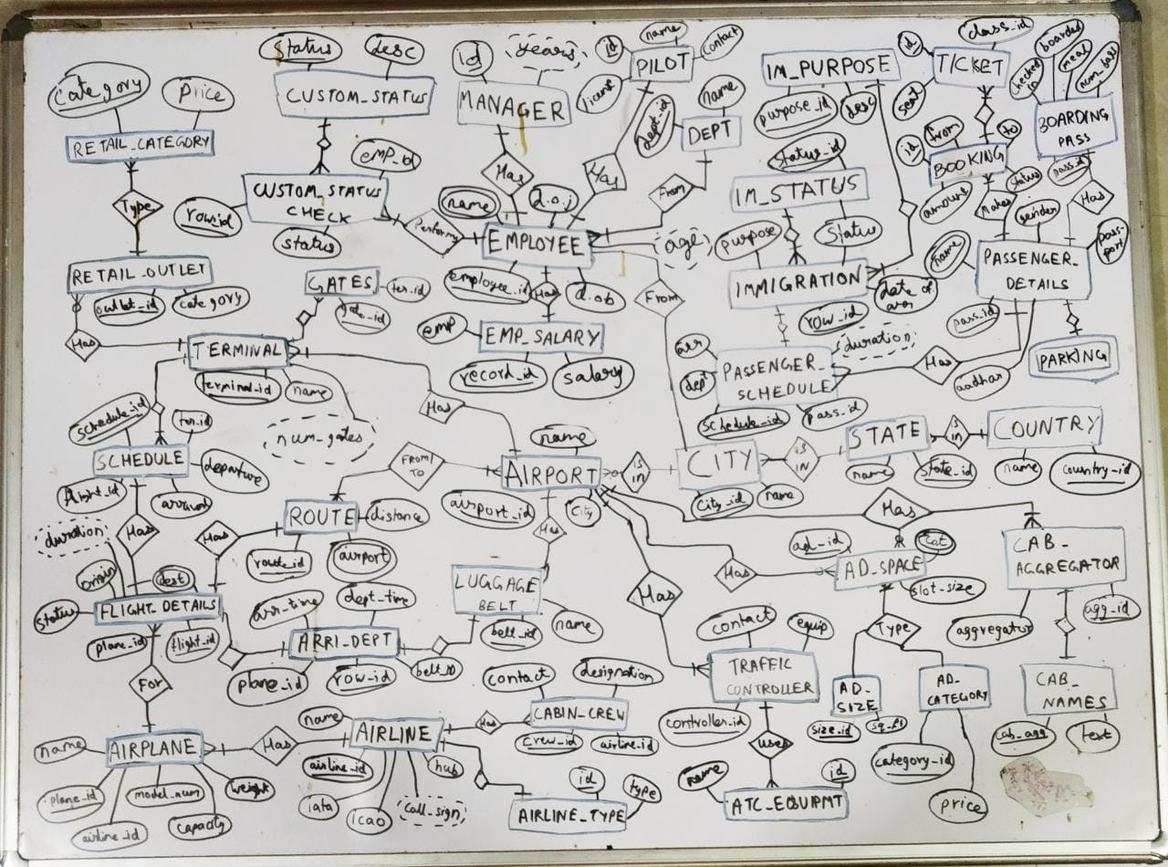

Slide 9
Database Diagram

Slide 10
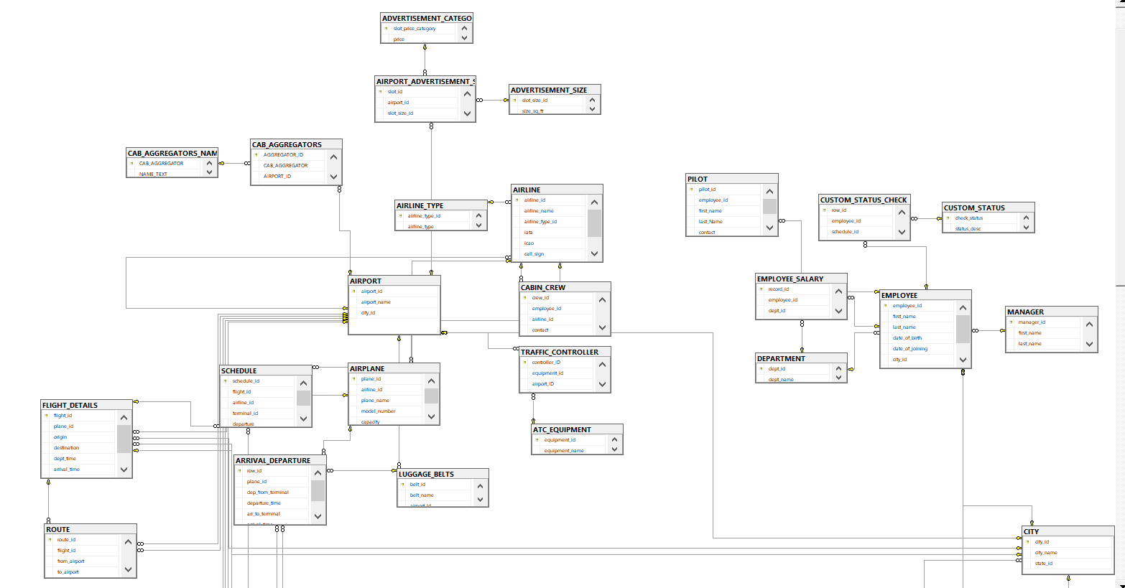

Slide 11
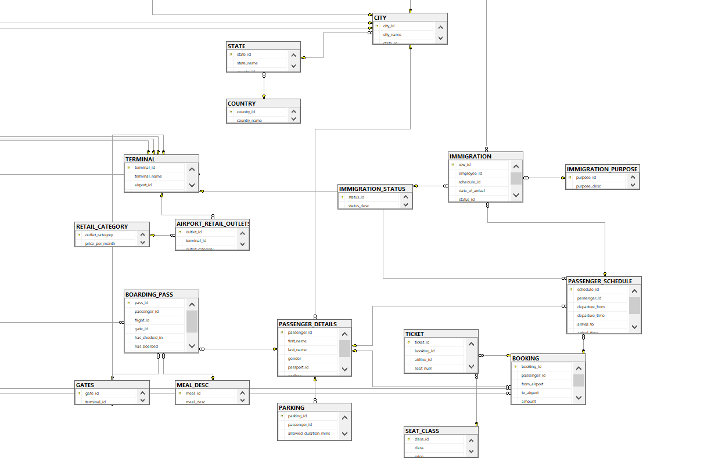

Slide 12
Deployment Files
DB and Table Creation File
SQL Queries File

Slide 13
SQL Queries Screenshots

Slide 14
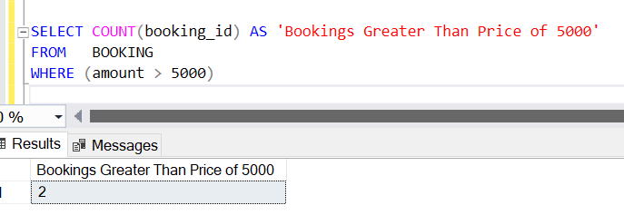
Query 1
Find out count of flight bookings with an amount greater than 5000.

Slide 15
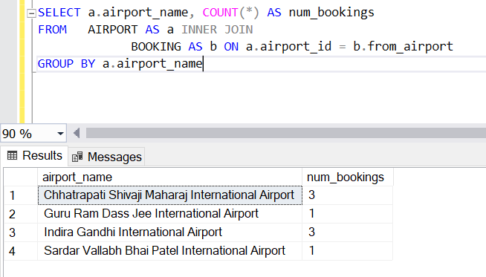
Query 2
Find out the number of bookings from each airport.

Slide 16
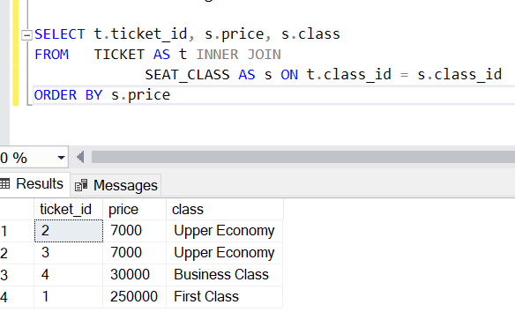
Query 3
Find out the tickets with their class.

Slide 17
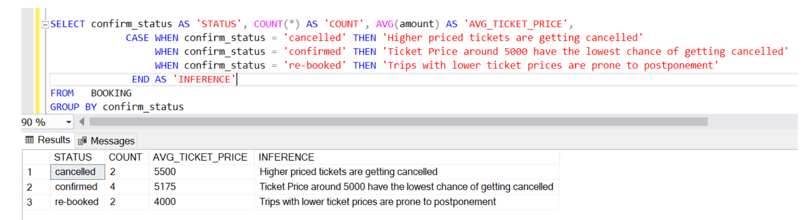
Query 4
Analysis of Ticket prices with Booking Status

Slide 18
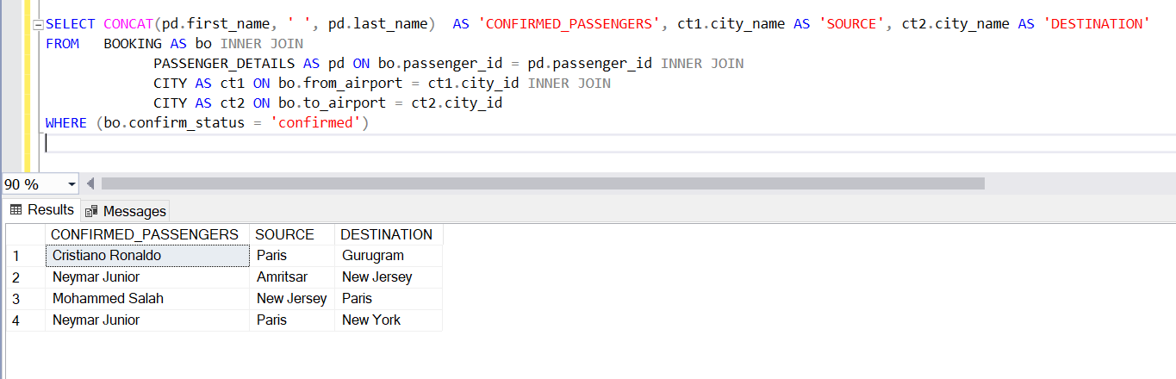
Query 5
Get the list of Confirmed Passengers and their travel plan

Slide 19
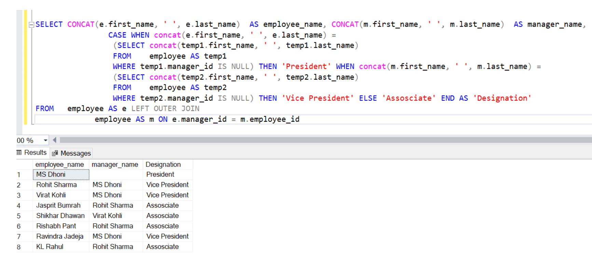
Query 6
Get the list of employees with their managers and designation as a derived attribute

Slide 20
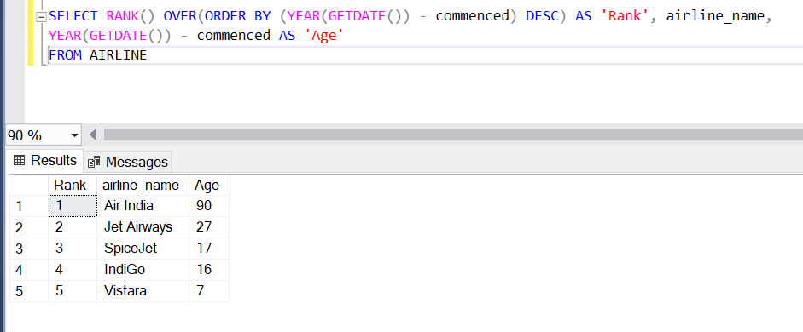
Query 7
Rank the airlines in terms of their age in descending order.

Slide 21
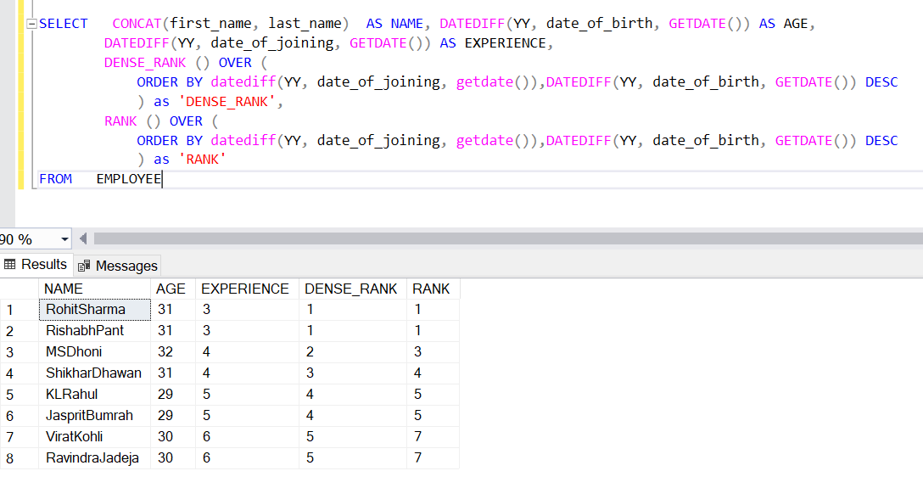
Query 8
Display the name, age and experience of all employees and rank them based on their experience in the company.

Slide 22
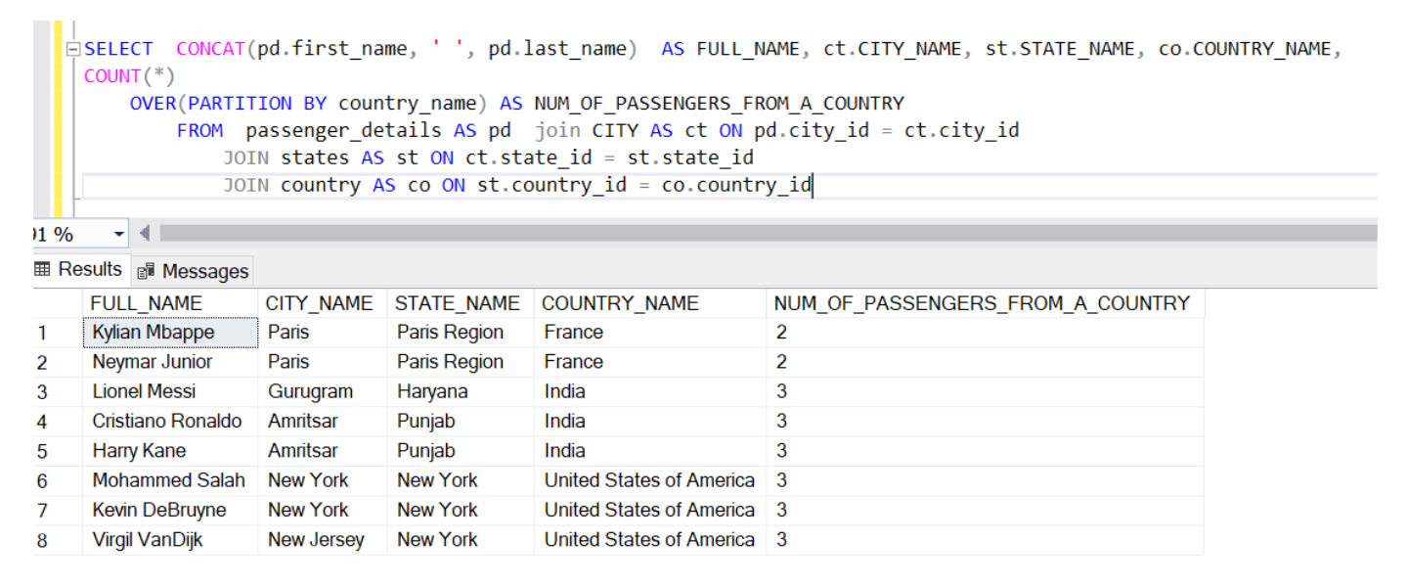
Query 9
Get the details of passengers with respect to the countries they are from, details should include city and state for each of them as well

Slide 23
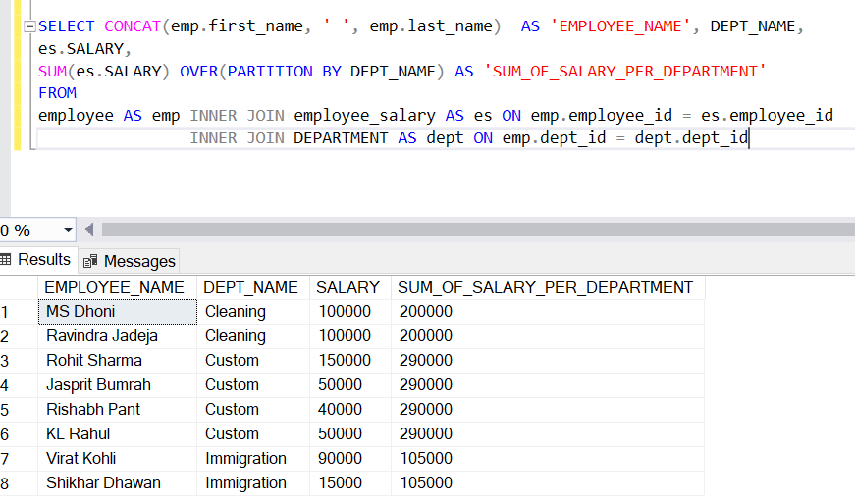
Query 10
Sum of Salary per Department, including details of salary for each employee and their department names.

Slide 24
Thank You

